Slide 1
Requirement Model
— Peer-Review Web App

Slide 2
Timeline
email everyone to
collect
manuscripts
email everyone to
recruit
reviewers
email reviewers to
pick up assigned manuscripts
submit Manuscript
show interest as a reviewer
SWC matching
complete review
Meeting
Deadline 1
Deadline 2
Deadline 3

Slide 3
Timeline Revised
email reviewers to
pick up assigned manuscripts
Deadline 1, 2
Deadline 3
show interest as a reviewer
SWC matching
email everyone to
collect manuscripts & recruit reviewers
complete review
Meeting
submit Manuscript
Manucripts collection
&
reviewer recruit
Paper pick up
&
Reviewing

Slide 4
Submission
select submission
pool is full
submit later
Personal Info
Agreement form
Submission
Submission reminder
Submission confirmation
available now
provide email address
yes
no
registered user
new user
sign in with email address
provide personal info
valid passwd
try again
info missing
invalid passwd
all info
prompt for reentry
sign agreement form
ask for help
submit manuscript
agree
disagree
get confirmation email for successful submission
finished
no,
continue
get reminder email for submission deadline
unfinished
finish it later
yes

Slide 5
Administration
Admin browsing manuscripts/reviewers and making final matching decisions
(see next page)

Slide 6
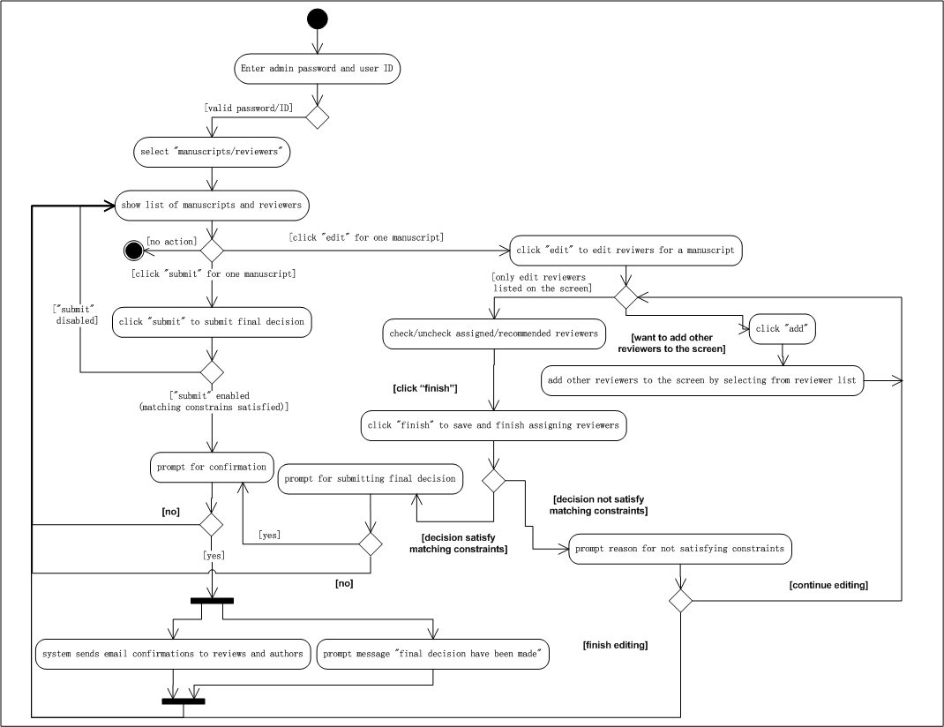
Administration

Slide 7
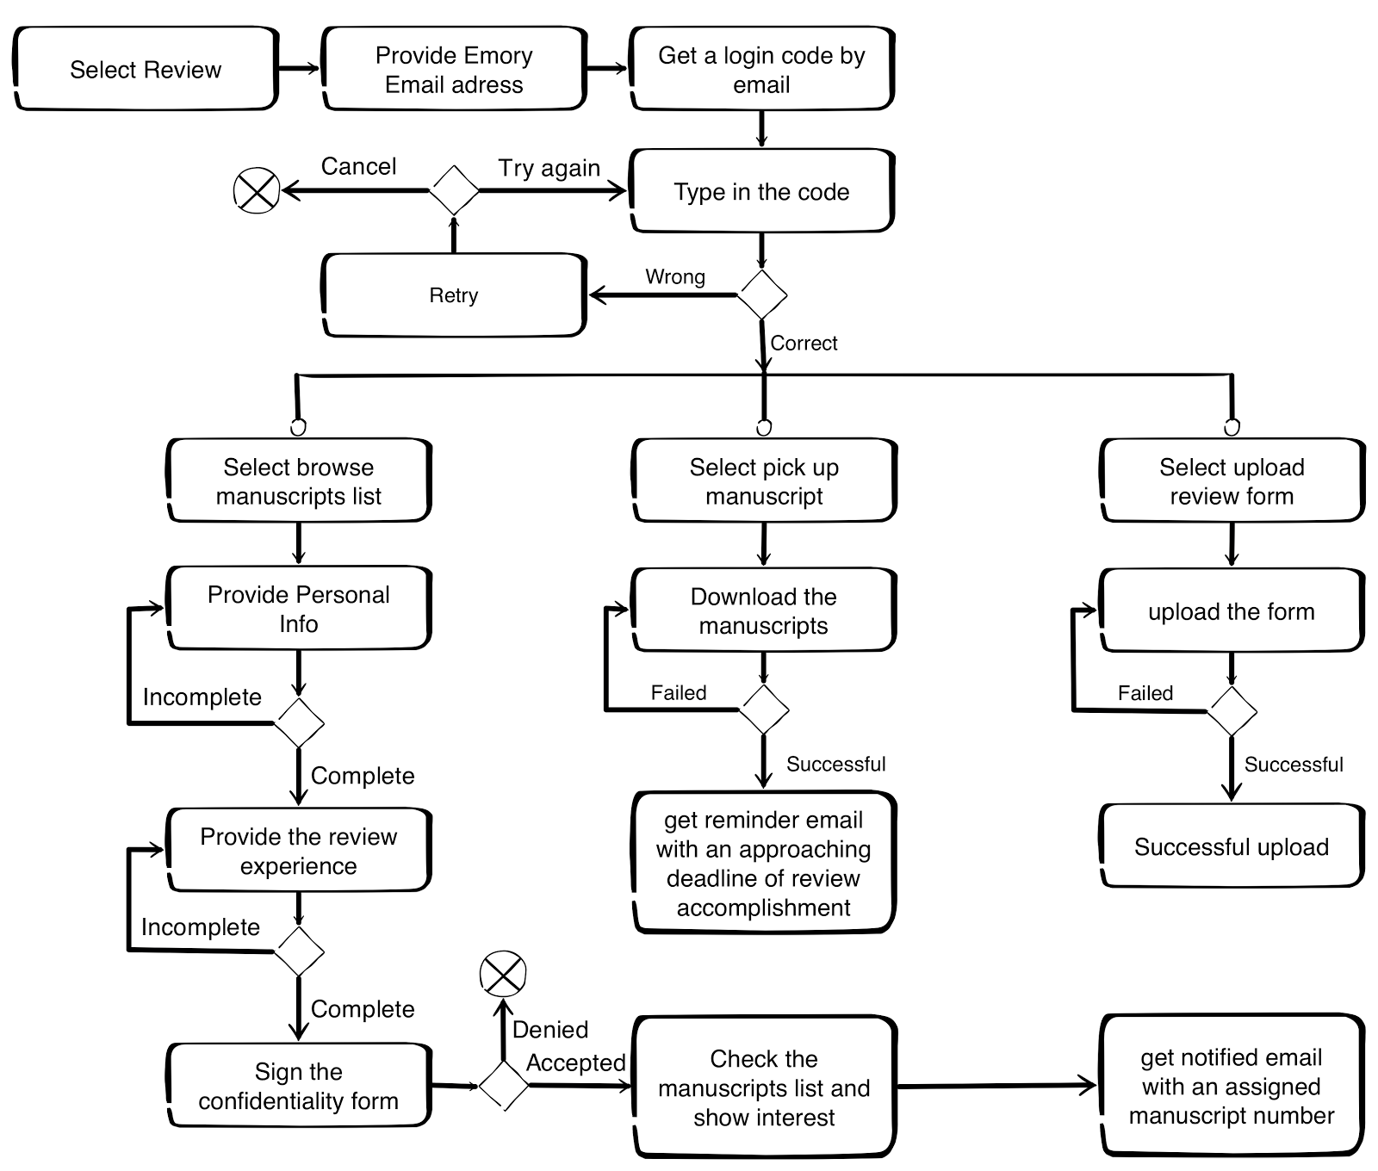
Review
Sign the form
Review experience
Check paper list
Show interest
Notification email
Reminder email
Upload review form

Slide 8
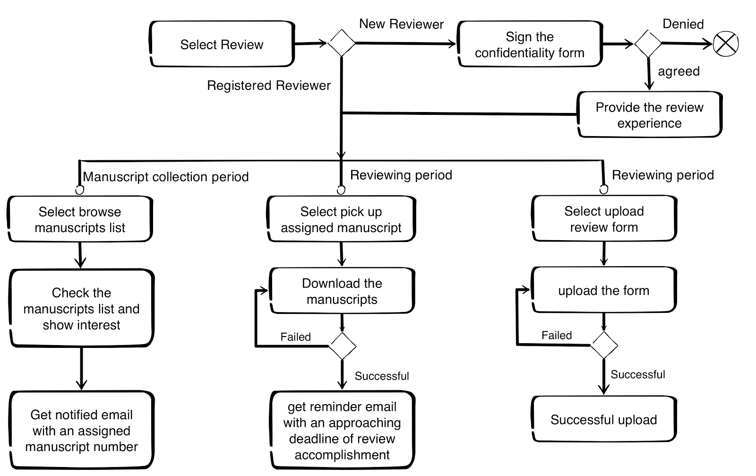
Review

